Slide 1

E-waste facility locator
ABES Engineering College, Ghaziabad, UP
Department of CSE-AIML
Mini Project KCS554 Presentation
Project Domain: Machine Learning
Project ID: B15
Project guide: Mr. Dhyanendra sir
Team members:
Priyanshu sahu (2100321530126)
Kostubh (2100321530089)
Mayank Yadav (2100321530101)

Slide 2
Contents
Introduction
Requirements of Project
Existing Work related to Project
Analysis of Problem Based on Project Objective
Brief description of the project along with goals and scope.
Initial phase of implementation

Slide 3
Introduction
E-waste, short for electronic waste, refers to discarded electronic devices that have reached the end of their useful life or are no longer wanted. This category of waste includes a wide range of electronic items, such as computers, laptops, smartphones, tablets, televisions, printers, electronic appliances, and more.

Slide 4
Requirements of Projects
User-friendly Interface
An intuitive platform that allows users to easily locate nearby e-waste disposal facilities.
Comprehensive Database
A robust repository of authorized e-waste facilities to ensure accurate and up-to-date information.
Map Integration
Seamless integration with maps to provide real-time directions and navigation to chosen facilities

Slide 5
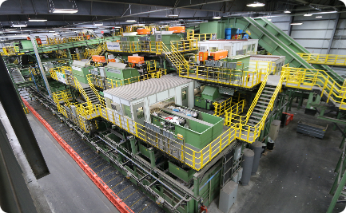
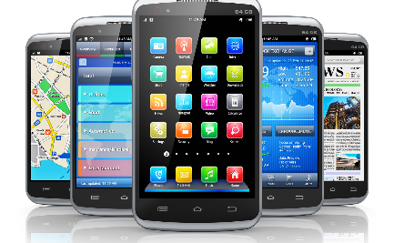

Existing Work related to Project
Recycling Centers
E-Waste Disposal Apps
Specialized Programs
Various recycling centers have made efforts to accept e-waste. However, locating them can still be cumbersome for users.
Several apps exist for e-waste disposal, but they lack comprehensive coverage and ratings for user-friendly decision-making.
Some regions have initiated specialized programs for the collection and recycling of specific e-waste items.

Slide 6
Project Objectives
1
Facility Discovery
Create a platform that allows users to easily discover nearby authorized e-waste disposal options.
2
Ratings & Reviews
Enable users to rate and leave reviews for e-waste facilities, aiding others in making informed choices.
3
Sustainability Promotion
Promote environmental consciousness by encouraging responsible recycling practices for a cleaner future.

Slide 7
Analysis of Problem Based on Project Objective
1
Fragmented Information
2
Lack of Ratings
3
Inefficient Search Processes
Current information on e-waste disposal options is scattered across multiple platforms, leading to confusion.
Users often face difficulty in evaluating the credibility and reliability of e-waste facilities.
Wasting time and effort on ineffective search methods is a common problem for individuals seeking proper disposal solutions.

Slide 8
Initial phase of implementation
User Research
Database Development
User Interface Design
Understand user preferences and pain points when it comes to e-waste disposal.
Compile comprehensive information on authorized e-waste facilities.
Create an intuitive and visually appealing interface for easy facility discovery.
Categorize facilities based on location, accepted items, and recycling processes.
Survey existing user experiences to inform platform design.
Integrate map functionality to provide seamless navigation.
Implement quality control measures for accurate data.
Identify accessibility requirements for different user groups.
Prioritize accessibility and responsiveness across devices.

Slide 9
References
1.
"Exploring E-Waste Management and Green Computing: A Qualitative Research" - Journal of Cleaner Production
2.
"China Is Profiting Big From The Global E-Waste Problem" - Vice
"EPA Electronics Waste Management Toolkit" - United States Environmental Protection Agency
3.

Slide 10
Thank You !

